Slide 1
Crime rate vs Income

Slide 2
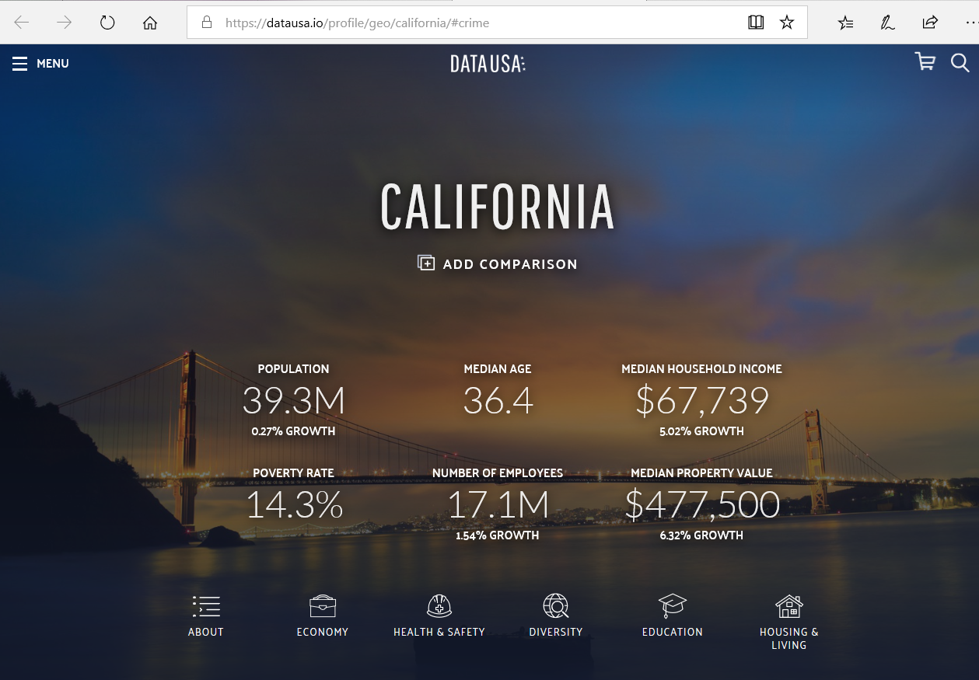
Data Source

Slide 3
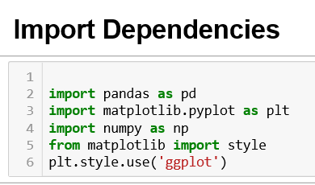
Import Dependencies

Slide 4
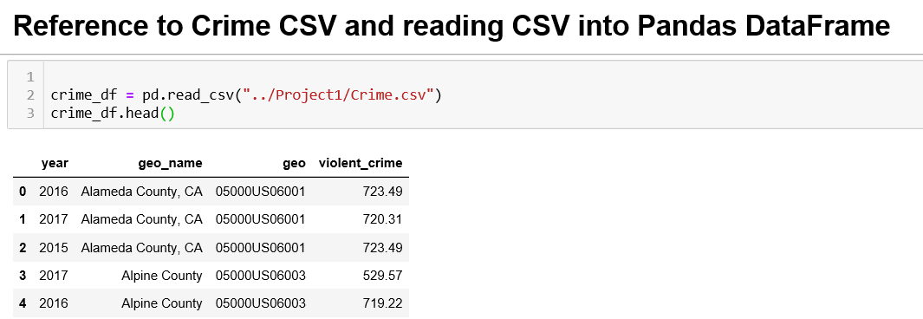

Import Data into Pandas DataFrame

Slide 5
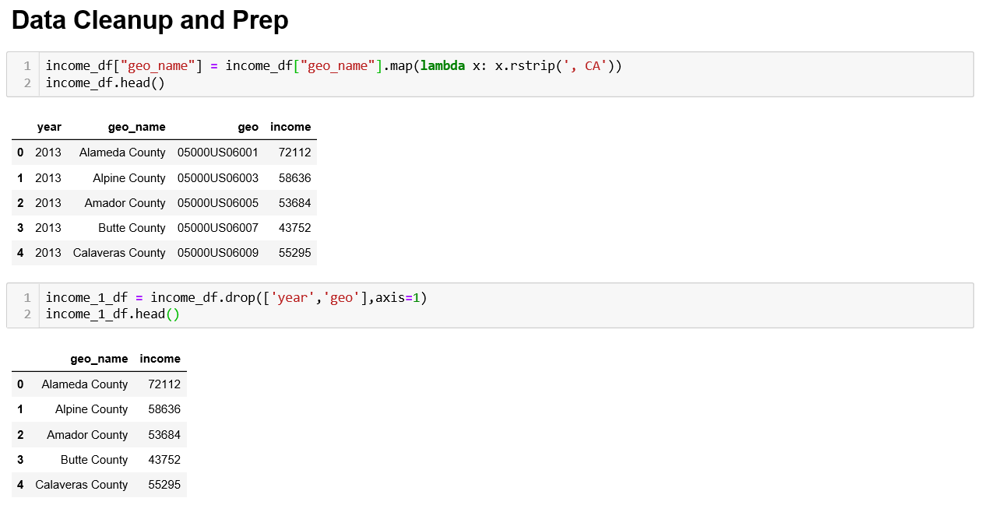
Data Cleanup and Prep

Slide 6
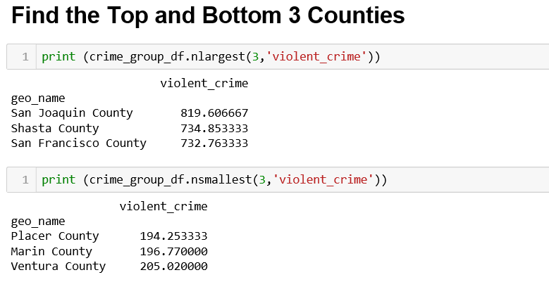
Find Top and Bottom 3 Counties

Slide 7
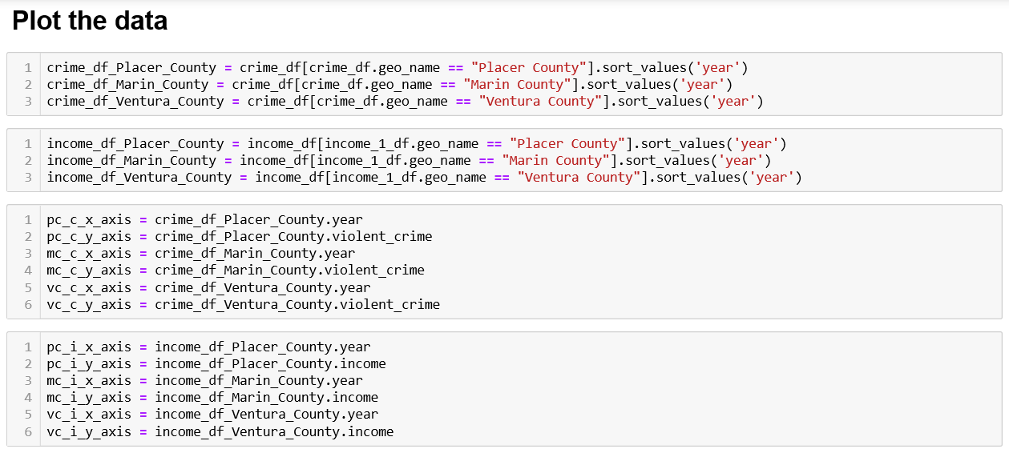
Plot the data

Slide 8
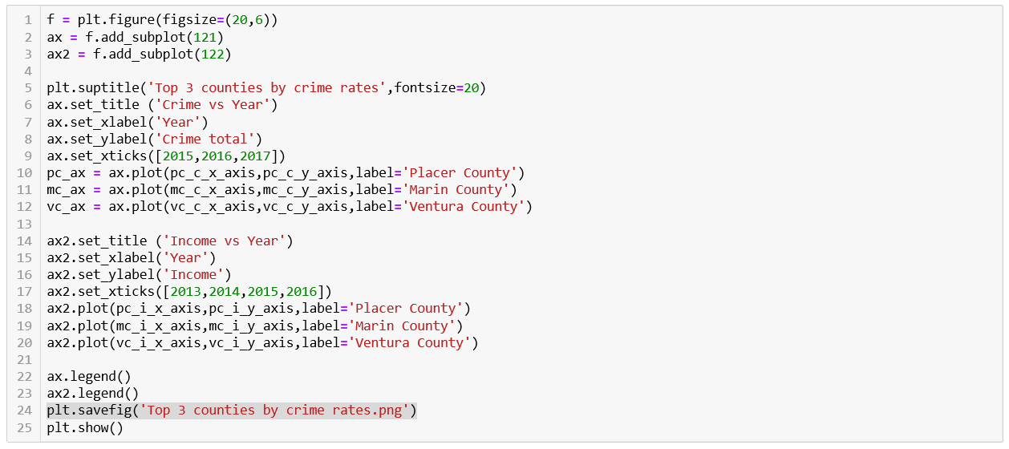
Plot the data

Slide 9
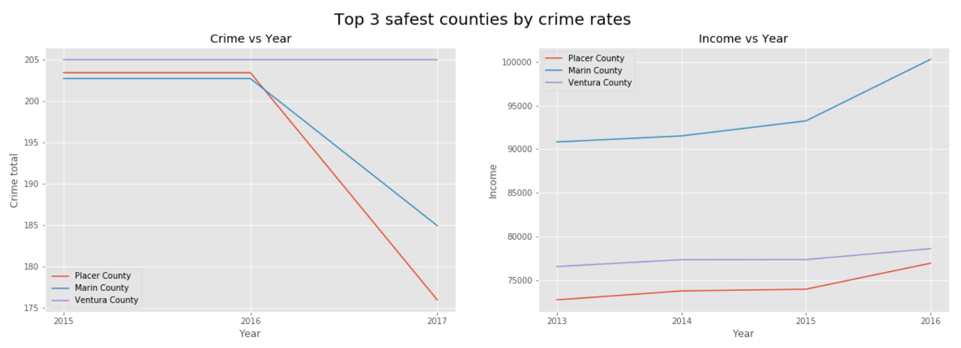
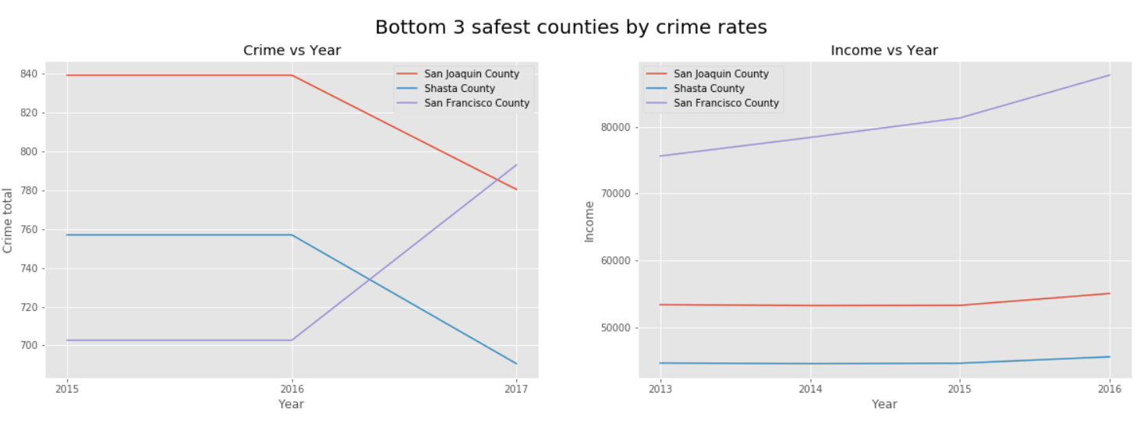
Top and bottom 3 counties by crime rates

Slide 10
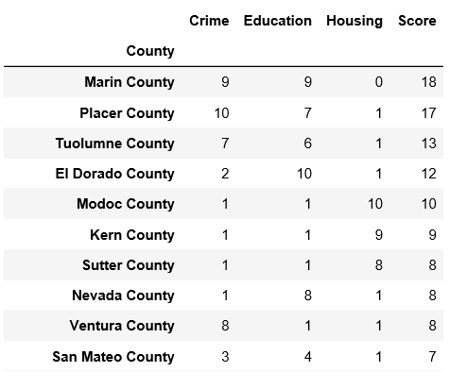
Final Top 10 Counties Scores

Slide 11
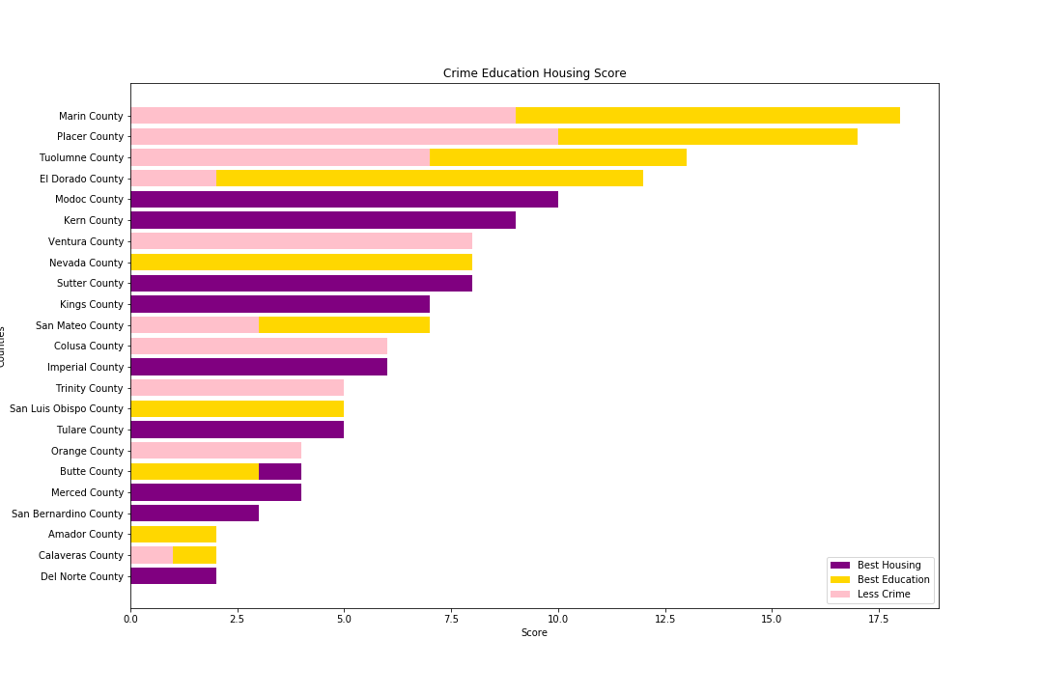
Overview

